Slide 1
FUNCTIONAL UI FUNCTIONAL AppS
Don Syme, Microsoft Researcher, F# Contributor
+ assistance from Timothé Larivière, Zaid-Ajaj, Mark Allibone, Jim Bennett, Jason Imison, Miguel de Icaza, Phillip Carter, Fabulous Community Contributors

Slide 2








thanks
Timothé Larivière also Zaid-Ajaj
co-maintainer on Fabulous, author of ElmishContacts and ElmishPlanets demos
Jim Bennett
Great talks on Fabulous!
Mark Allibone
Swiss MVP , @mallibone
Frank Krueger
ImmutableUI was inspiration and initial partial list of Xamarin.Core bindings
Boris D. (github @dboris)
authored “Elmish.Forms” (“half-elmish” for static views only)
Jason Imison
F# in Visual Studio for Mac and Xamarin
Eugene Tolmachev
Creator or “Elmish” for Fable, used for WPF and others
Justin Sacks and others
Creators of “Elmish.WPF” (“half-elmish” for static views only)
Alfonso, Maxime, Steffen and many others
The Fable gang

Slide 3


Slide 4
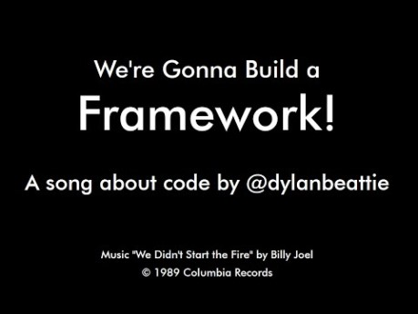

Slide 5
First, a little about F#

Slide 6


Slide 7

www.microsoft.com/net/

Slide 8
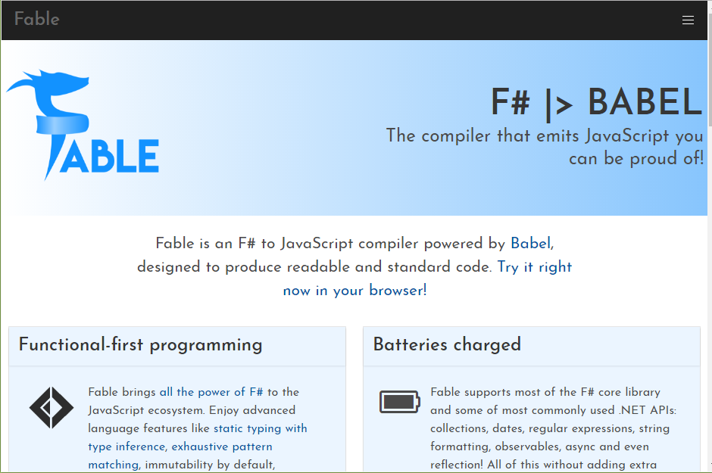

Slide 9
F# for the back-end github.com/giraffe-fsharp/Giraffe

Slide 10
F# for the front-end (today’s talk)

Slide 11
TL;DR – Where we are now
F# is open, cross-platform, neutral, independent
The F# Compiler Service powers other tools
F# 4.6 now complete!
.NET Core for Linux/OSX
All F# language and tooling is accepting contributions
Fable for F#-to-Javascript
SAFE for F# fullstack
The F# community is self-empowered
fsharp.org
VSCode, VS for Windows, Mac
Xamarin tools for Android, iOS, macOS etc.

Slide 12

Enterprise Ready, Community Centred fsharp.org - A Foundation at the heart of the Community Microsoft act as gate keepers and quality control, by agreement with community Microsoft is part of the community, so are others F# Conferences run by the F# Community

Slide 13
The F# Language Design Process github.com/fsharp/fslang-design github.com/fsharp/fslang-suggestions

Slide 14
F# 4.0 ✔ True shift to cross-platform open engineering ✔ Long laundry list of language items ✔ Normalized core library ✔ Type providers more powerful ✔ Better debugging, tooling, performance ✔ ~20% compiler perf improvement
https://github.com/fsharp/fslang-design/tree/master/FSharp-4.0

Slide 15
F# 4.1 ✔ Optional large scope cycles more on this later) ✔ Result<T,Error> in standard library ✔ Unboxed (struct) tuples ✔ Unboxed (struct) records ✔ Unboxed (struct) unions ✔ More bits and pieces
https://github.com/fsharp/fslang-design/tree/master/FSharp-4.1

Slide 16
F# 4.5 ✔ Span<T> high perf type-safe non-allocating code ✔ Improved async debugging ✔ More bits and pieces
https://github.com/fsharp/fslang-design/tree/master/FSharp-4.5

Slide 17
F# 4.6 ✔ Anonymous records ✔ More bits and pieces
https://github.com/fsharp/fslang-design/tree/master/FSharp-4.5

Slide 18
F# 4.7 ✔ Implicit yields ✔ /langversion ✔ indentation relaxations
https://github.com/fsharp/fslang-design/tree/master/FSharp-4.5

Slide 19
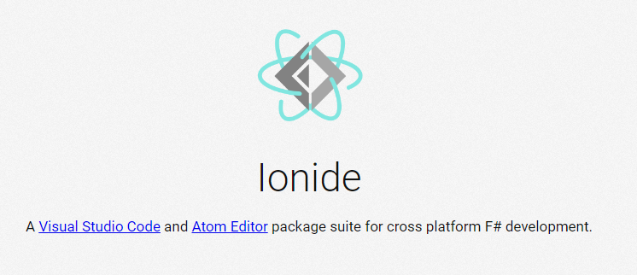
VSCode + Ionide = Cross-Platform F# Editing Love

Slide 20
F# and .NET Core (Linux, OSX, Windows) dotnet new -lang F# dotnet build docs.microsoft.com/dotnet/core/

Slide 21
LET THE REAL TALK BEGIN!

Slide 22
The context
Initially F# embraced functional-first programming
F# lacked opinion on functional-first UI and app development
Notes:
Some good options existed but hadn’t quite taken hold. “winforms designer! WPF designer! Xaml designer on Mac! webforms designer! Xcode designer! Class designer! class browser!”. Some semi-functional architectures too (WebSharper UI.Next, Gjallahorn, others). ReactNative and other options are perceived as being functional-friendly. Can we make Xamarin friendly for F# developers?

Slide 23

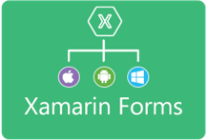












Situation: The world of UI is developing
OO programming
Complex mutable models
Declarative static UI
View in 2nd markup language
Complex designer tooling
Functional programming
Simple declarative models
Declarative dynamic UI
View in same language DSL
Simple live coding tooling
MVU
(model-view-update)
MVVM
(model-view-viewmodel)

Slide 24
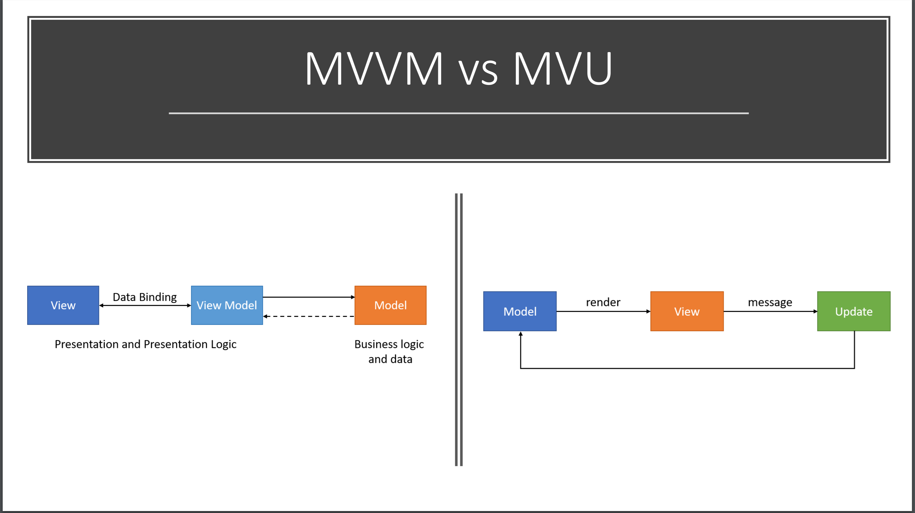

Slide 25
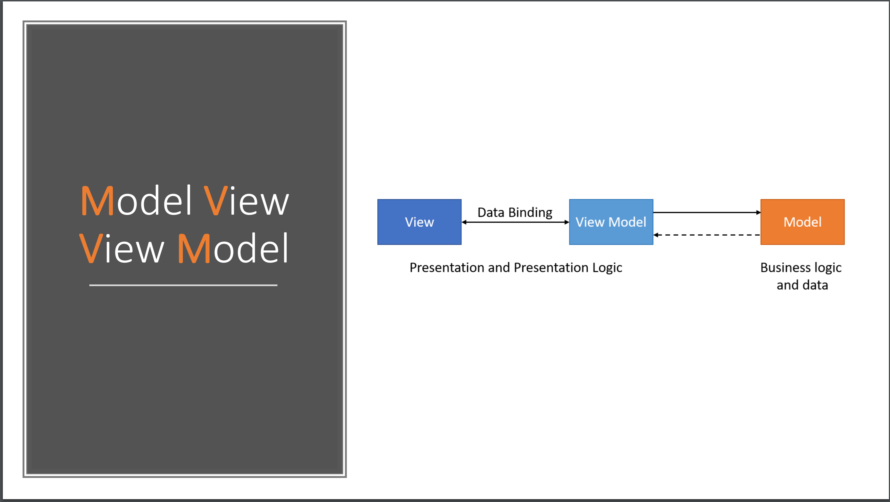

Slide 26
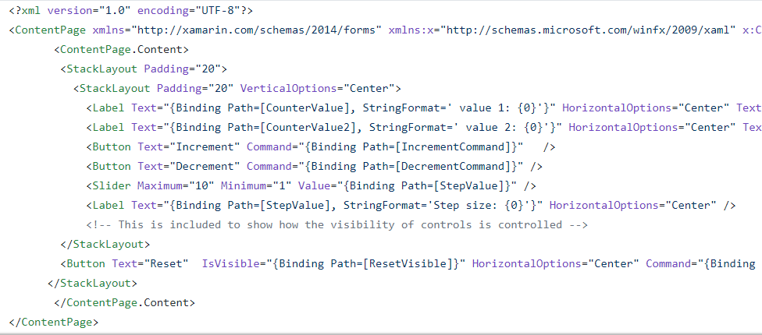
THE PROBLEM WITH XAML
Xaml looks like this:

Slide 27
THE PROBLEM WITH XAML
A core problem: Xaml
Xaml assumes “designers” will “sliced off” UI from code into a separate DSL.
Xaml is static, with layers of complexity (e.g. templating), and code-like constructs (behaviours, convertors), and requires complex designer tooling (which often fails).
Xaml stems from a fundamental category mistake in 2003 (“dynamic UI should be separated into a static markup language”)

Slide 28
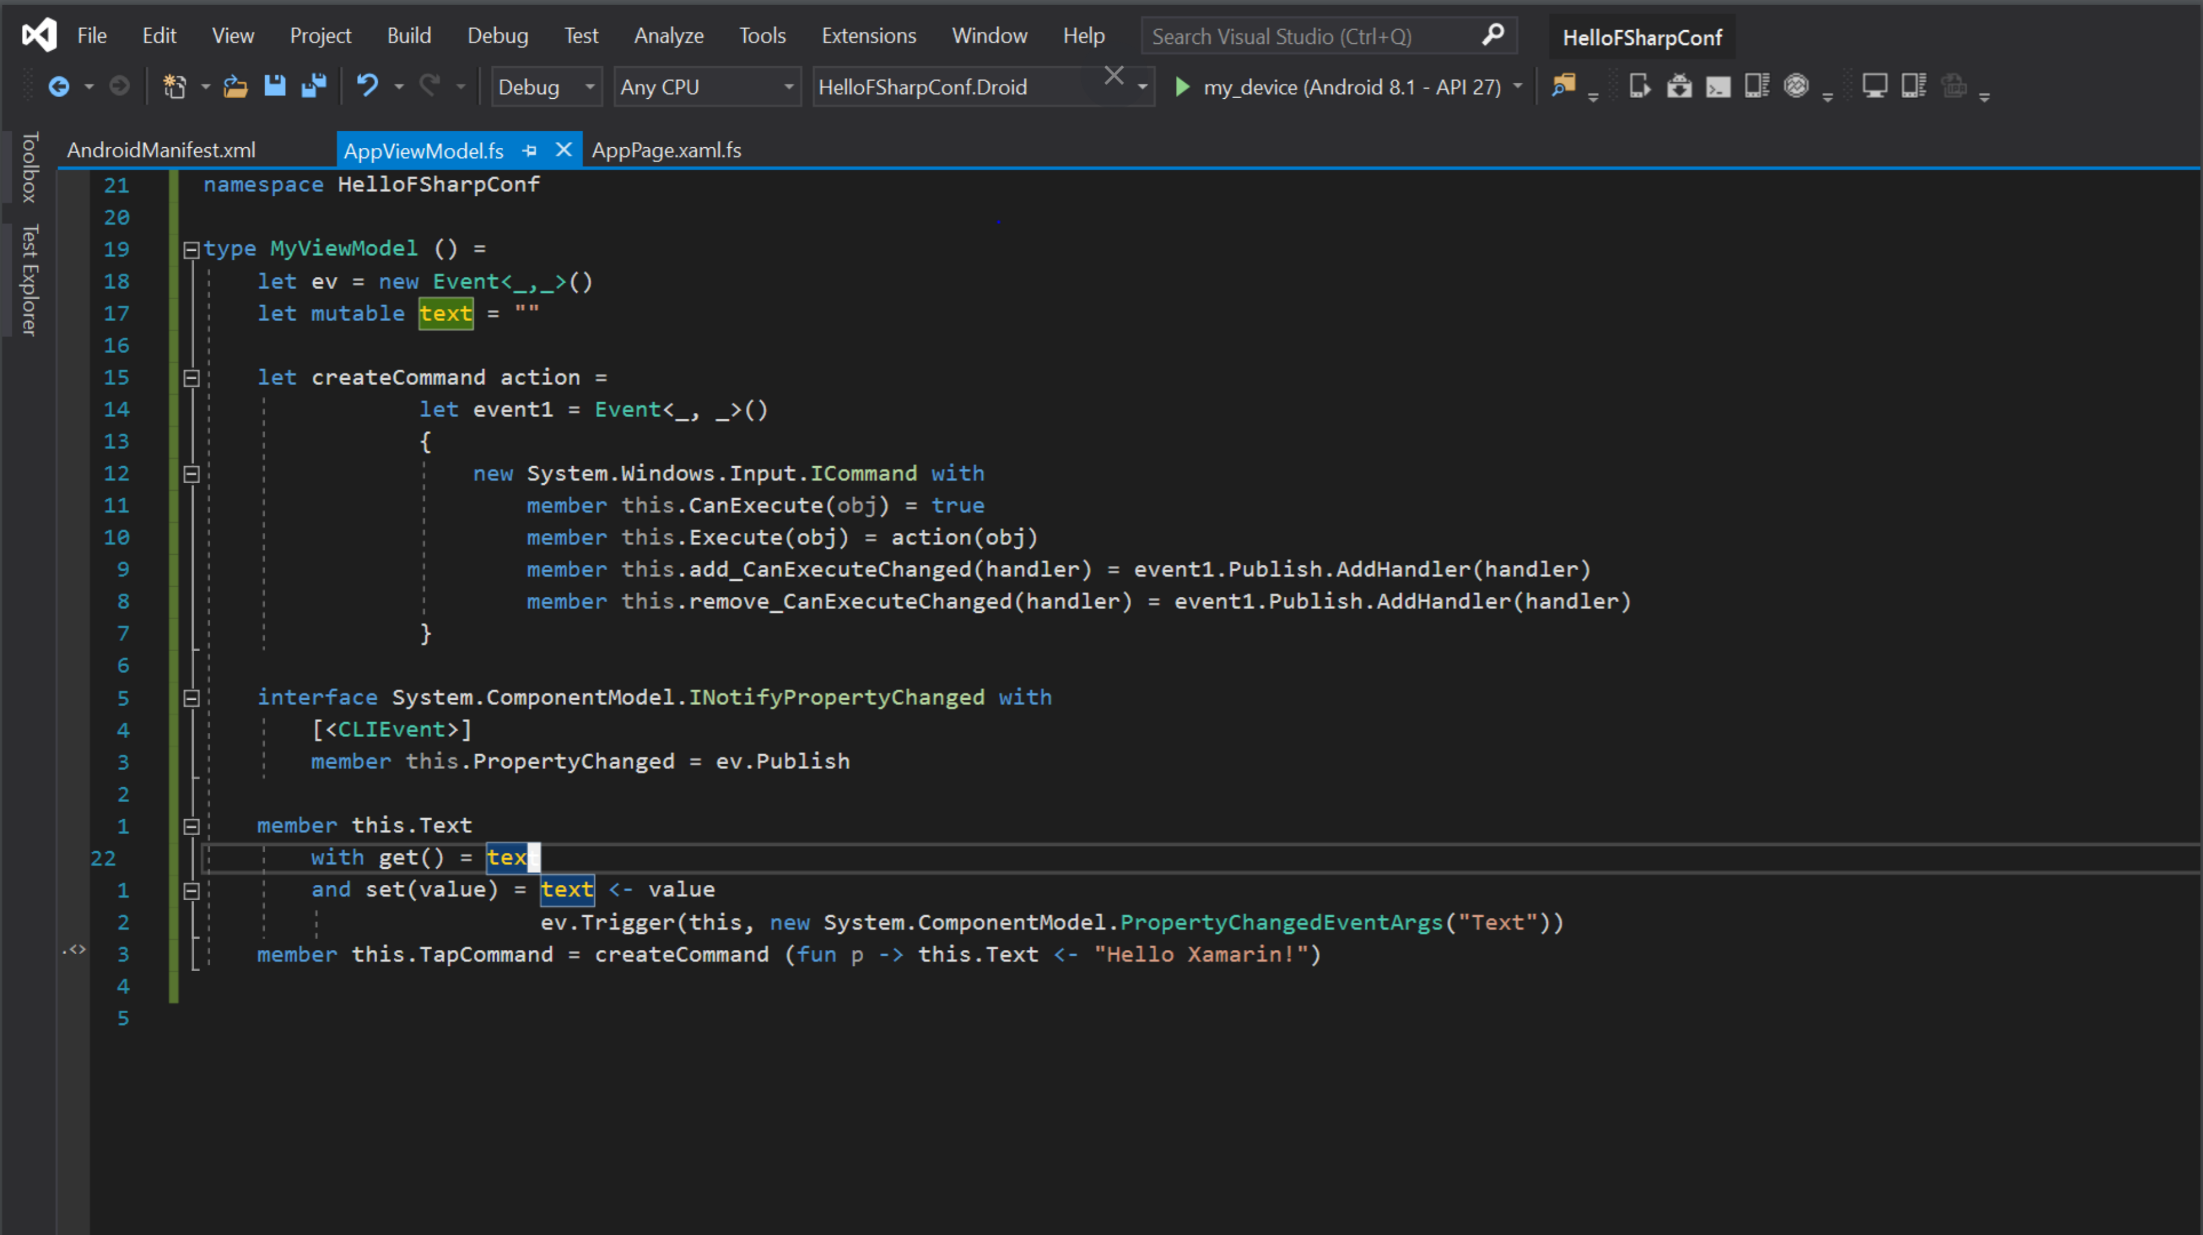

Slide 29
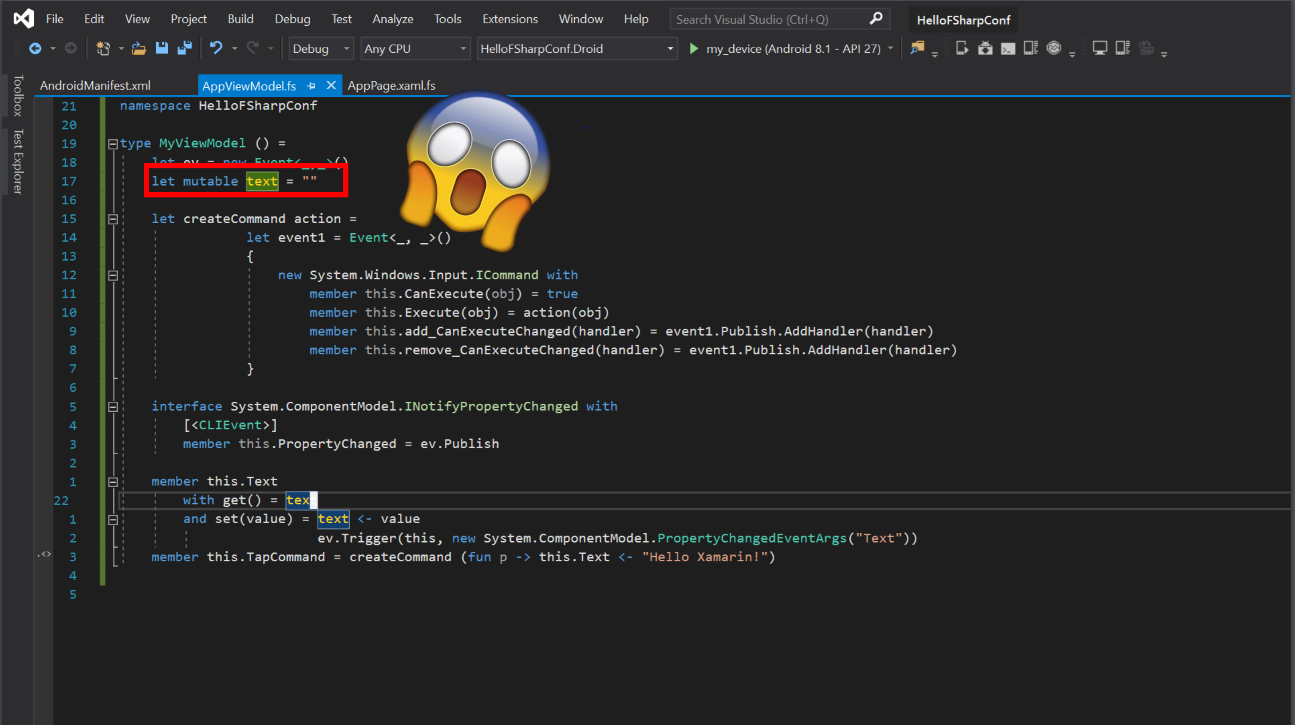

Slide 30
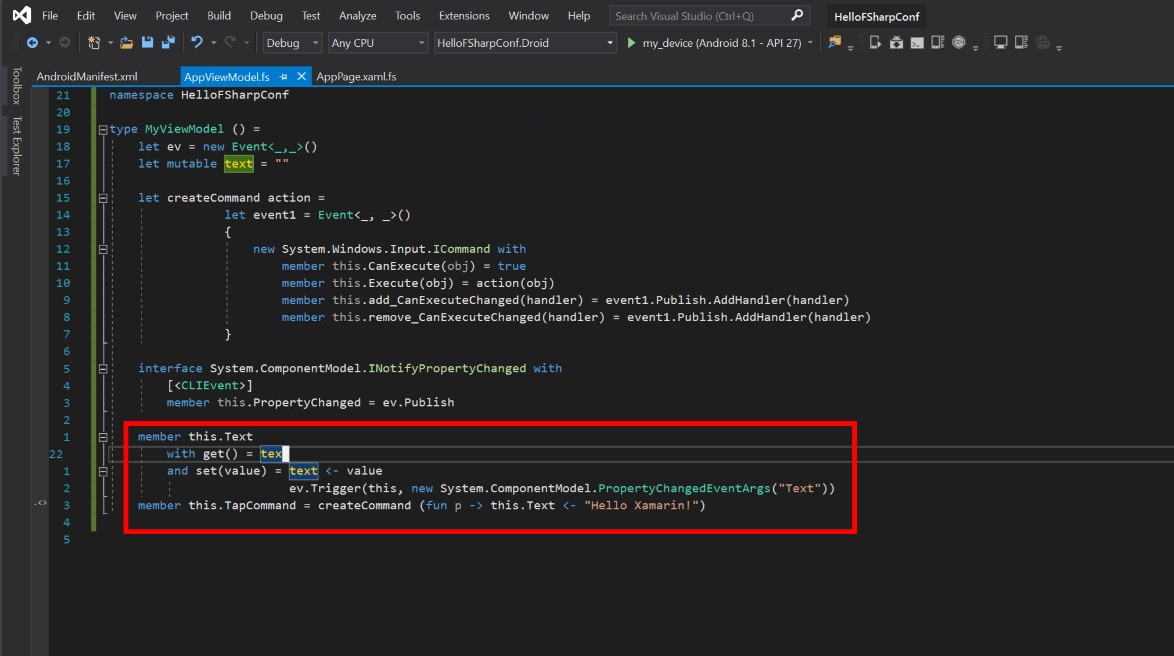

Slide 32
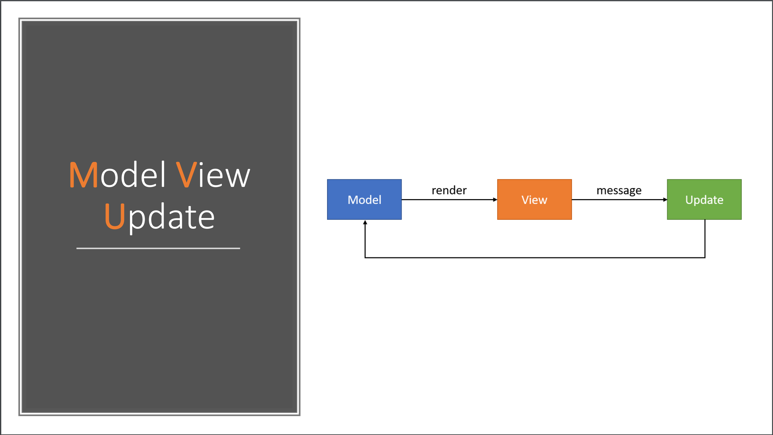

Slide 33
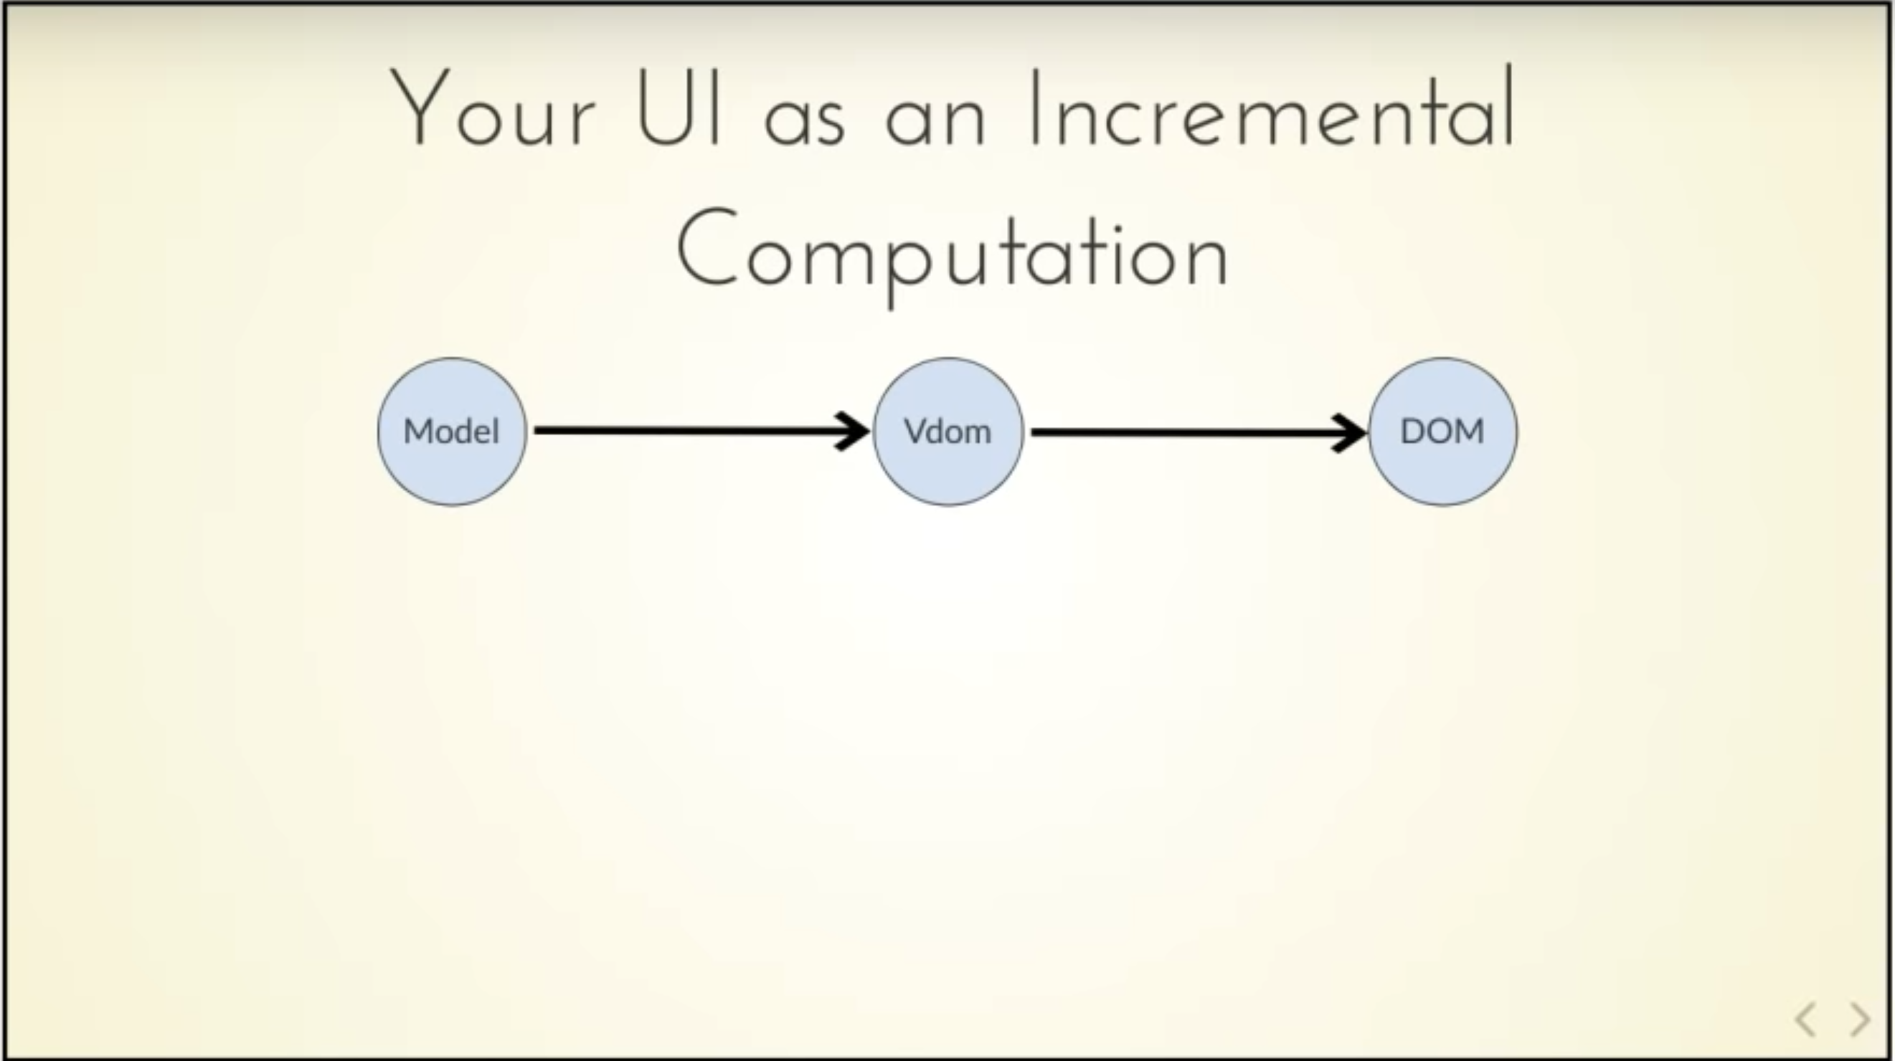


Slide 34
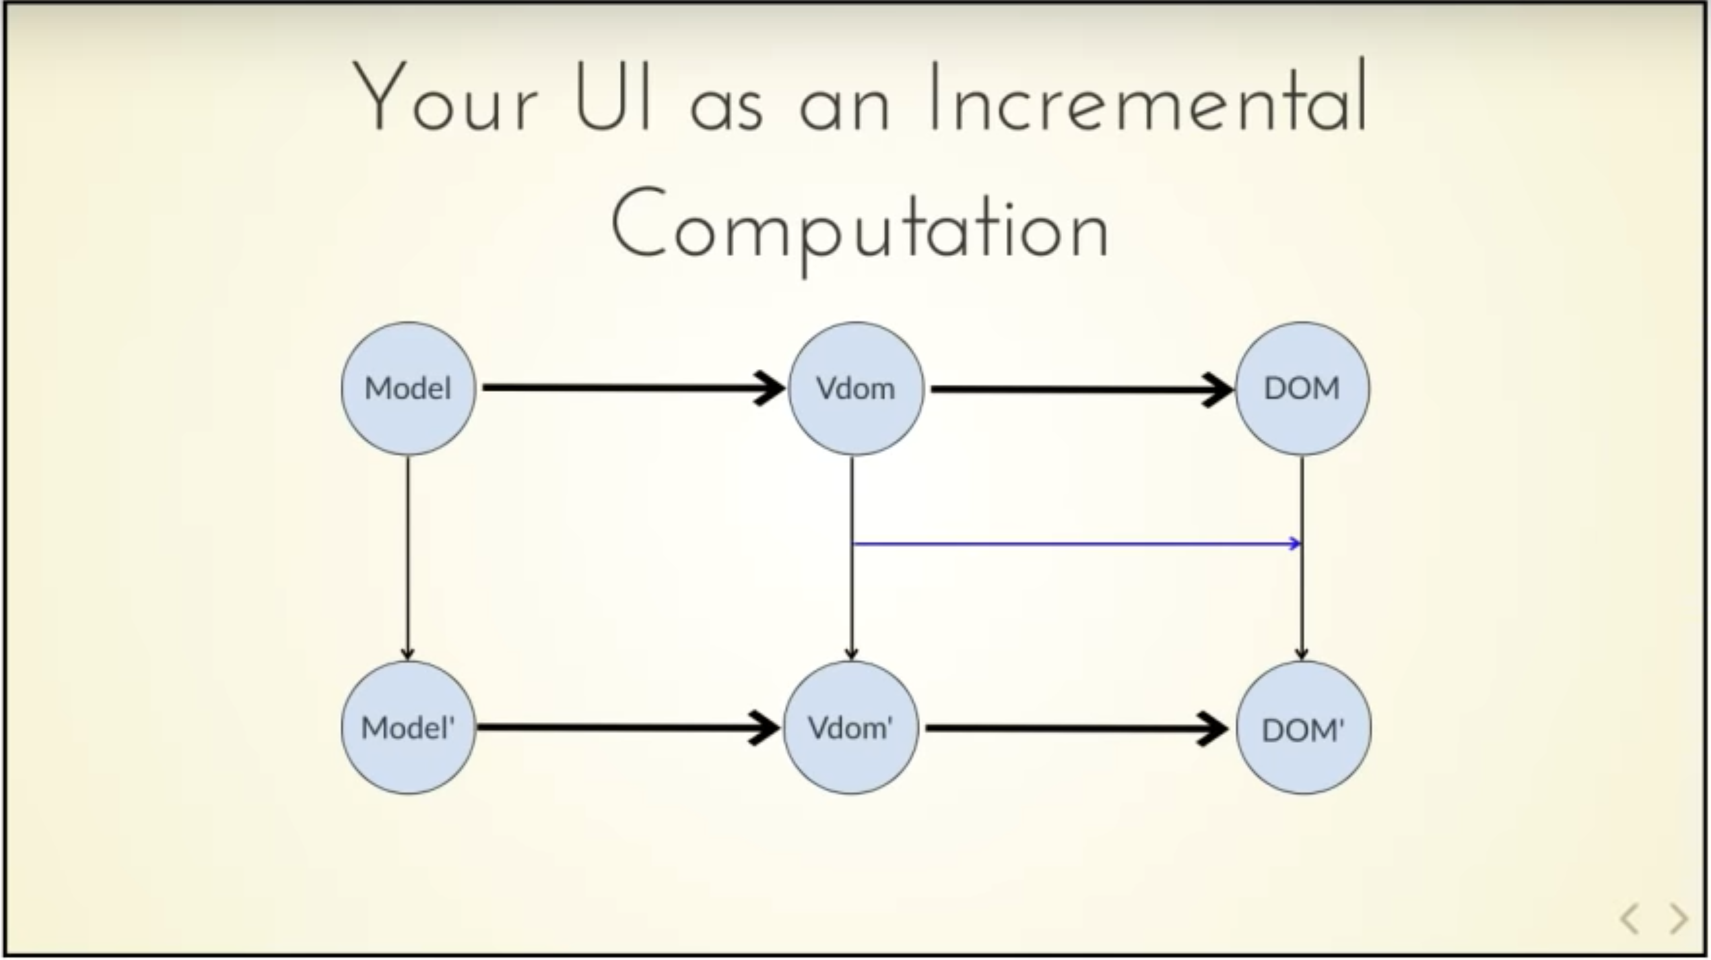
Δ

Slide 35


Slide 36
A Simple MVU App
type Model =
{ … }
type Msg =
| …
| …
let init() =
{ … }
let update msg model =
match msg with
| … -> { model with … }
| … -> { model with … }
let view model dispatch =
if … then
… label … (fun () -> dispatch msg) …
else
… button … (fun () -> dispatch ) …
The model from which
the view is generated
Messages which cause
updates to the model
Initial state
Update the model
Compute the view

Slide 37
A Simple MVU App
type Model =
{ IsPressed: bool }
type Msg =
| Pressed
let init() =
{ IsPressed=false }
let update (msg: Msg) (model: Model) =
match msg with
| Pressed -> { model with IsPressed = true }
let view (model: Model) dispatch =
if model.IsPressed then
View.Label(text="I was pressed!")
else
View.Button(text="Press Me!", command=(fun () -> dispatch Pressed))
The model from which
the view is generated
Messages which cause
updates to the model
Initial state
Update the model
Compute the view

Slide 38
It’s all just functional programming!
UI becomes calculation and information, not state…
Views are re-computed and differentially applied

Slide 39

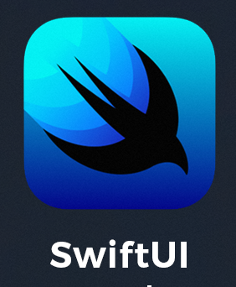

MVU and its variations are becoming ubiquitous

Slide 40
Fabulous – F# MVU for mobile
A model-view-update mobile app
/// The view function giving updated content for the page
let view (model: Model) dispatch =
if model.Pressed then
View.Label(text="I was pressed!")
else
View.Button(text="Press Me!", command=(fun () -> dispatch Pressed))

Slide 41
Fable Elmish – F# MVU for Web
A model-view-update web view
/// The view function giving updated content for the page
let view (model: Model) dispatch =
if model.IsLoading then
div [] [str "Loading..."]
else
div [ ClassName "container" ] [
button [ OnClick (fun _ -> dispatch Faster) ] [ str "Faster" ]
div [ ClassName "theText" ] [ str model.Text.[model.Index] ]
button [ OnClick (fun _ -> dispatch Slower) ] [ str "Slower" ]
div [] [ str (sprintf "Ticks Per Update: %d" model.TicksPerUpdate) ]
]

Slide 42
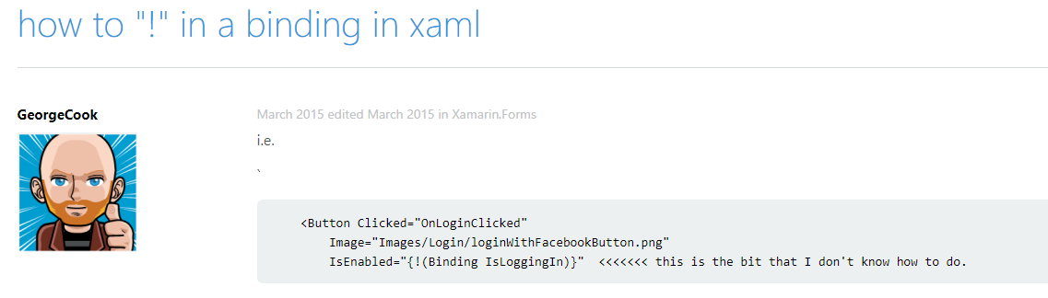
FABULOUS - THE PROBLEM WITH XAML

Slide 43
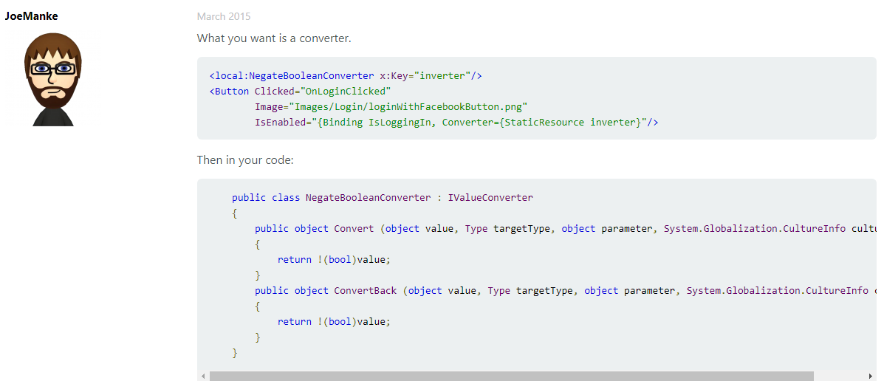
FABULOUS - THE PROBLEM WITH XAML

Slide 44
FABULOUS - THE PROBLEM WITH XAML
let view (model: Model) dispatch =
View.ContentPage(content=
View.StackLayout(padding=30.0,verticalOptions = LayoutOptions.Center, children=[
View.Label(text= string model.Count, horizontalOptions=LayoutOptions.Center)
View.Button(text="Increment", command= (fun () -> dispatch Increment))
View.Button(text="Decrement", command= (fun () -> dispatch Decrement))
View.Slider(minimum=0.0, maximum=10.0, value=model.Step,
valueChanged= (fun args -> dispatch (SetStep (int args.NewValue))))
View.Label(text=sprintf "Step size: %d" model.Step, horizontalOptions=LayoutOptions.Center)
View.Button(text="Reset", horizontalOptions=LayoutOptions.Center,
command=(fun () -> dispatch Reset), canExecute = model.Changed)
]))

Slide 45
FABULOUS - THE PROBLEM WITH XAML
View looks like this:
let view (model: Model) dispatch =
View.ContentPage(content=
View.StackLayout(padding=30.0,verticalOptions = LayoutOptions.Center, children=[
View.Label(text= string model.Count, horizontalOptions=LayoutOptions.Center)
View.Button(text="Increment", command= (fun () -> dispatch Increment))
View.Button(text="Decrement", command= (fun () -> dispatch Decrement))
View.Slider(minimum=0.0, maximum=10.0, value=model.Step,
valueChanged= (fun args -> dispatch (SetStep (int args.NewValue))))
View.Label(text=sprintf "Step size: %d" model.Step, horizontalOptions=LayoutOptions.Center)
View.Button(text="Reset", horizontalOptions=LayoutOptions.Center,
command=(fun () -> dispatch Reset), canExecute = not model.Unchanged)
]))
How easy is that?

Slide 46
FABULOUS - THE NEED
What’s needed?
the simplicity of MVU, but for Mobile and Desktop Apps

Slide 47
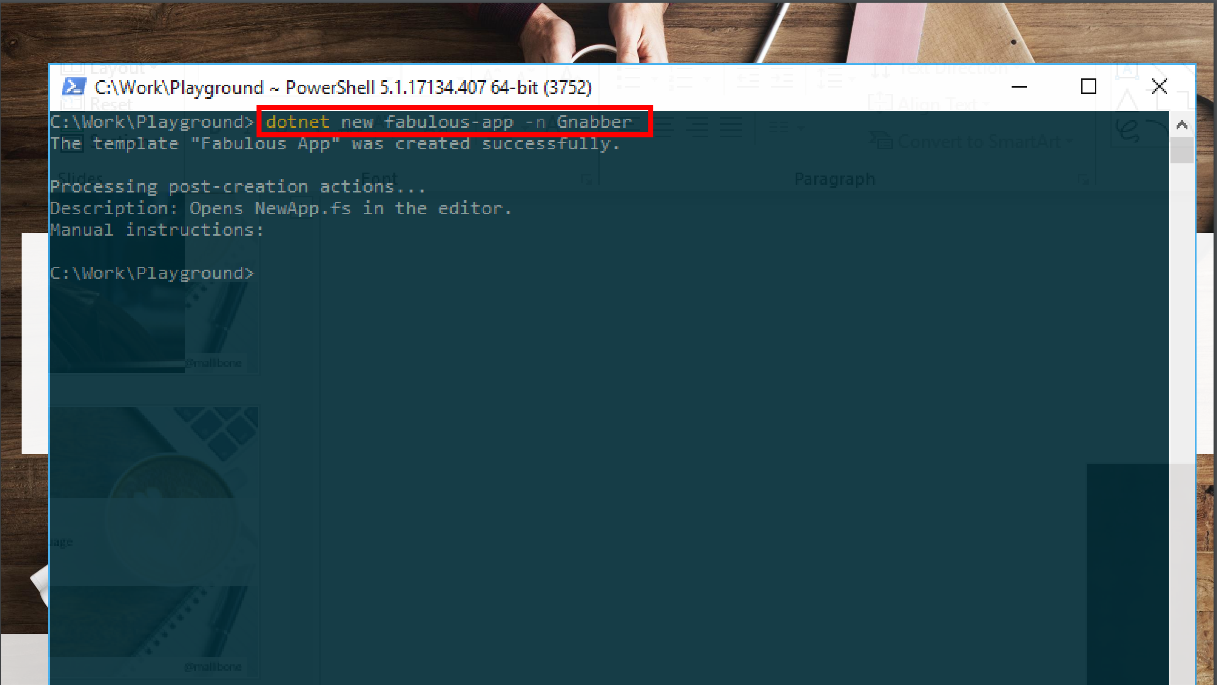

Slide 48


Slide 49
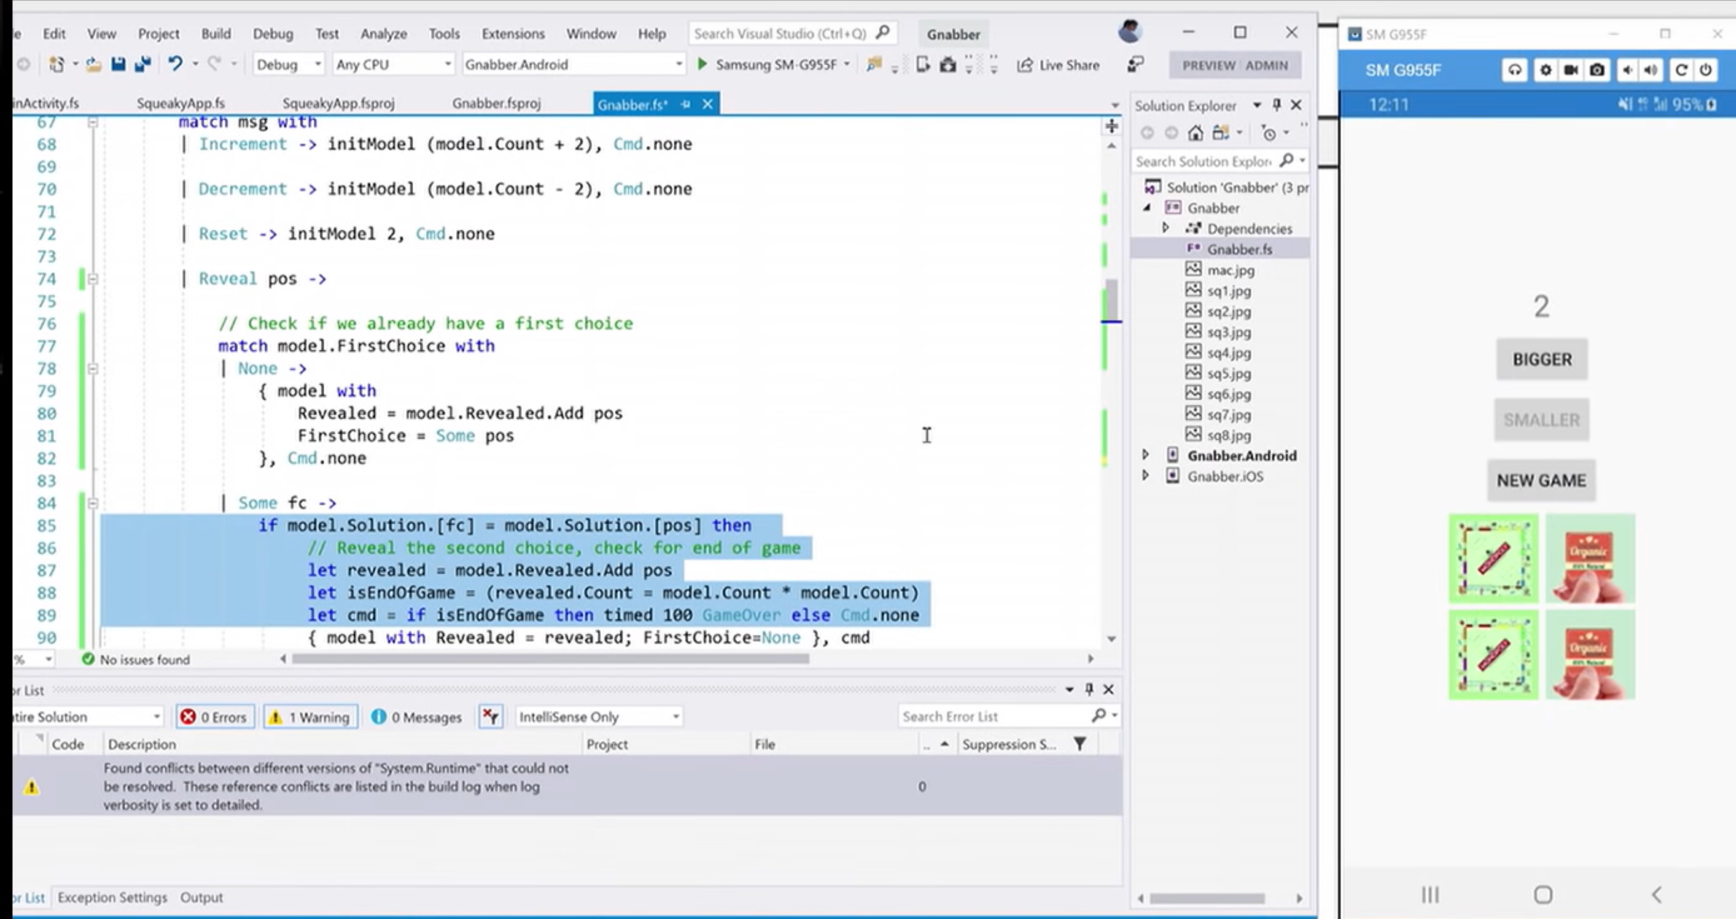

Slide 50
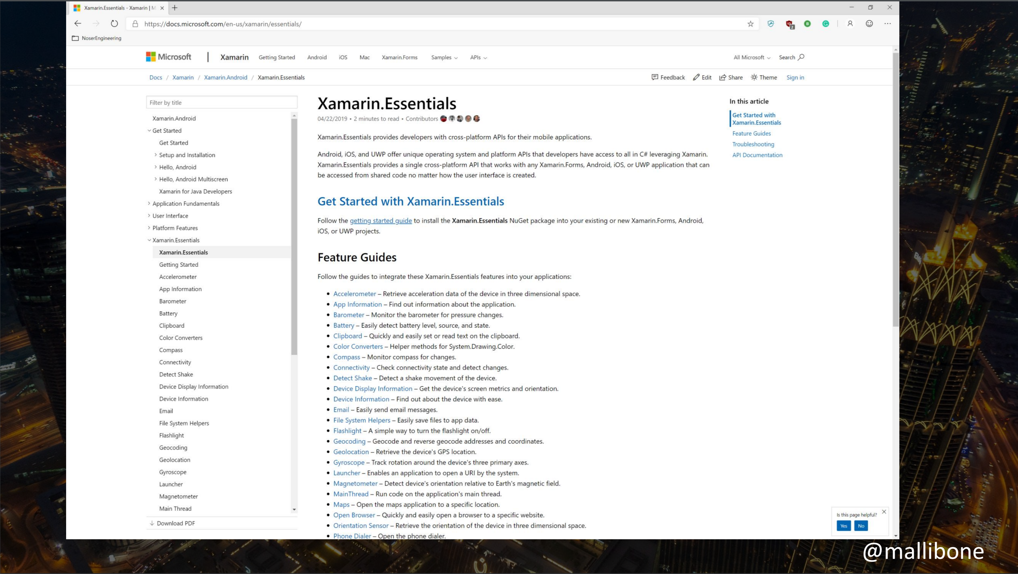

Slide 51
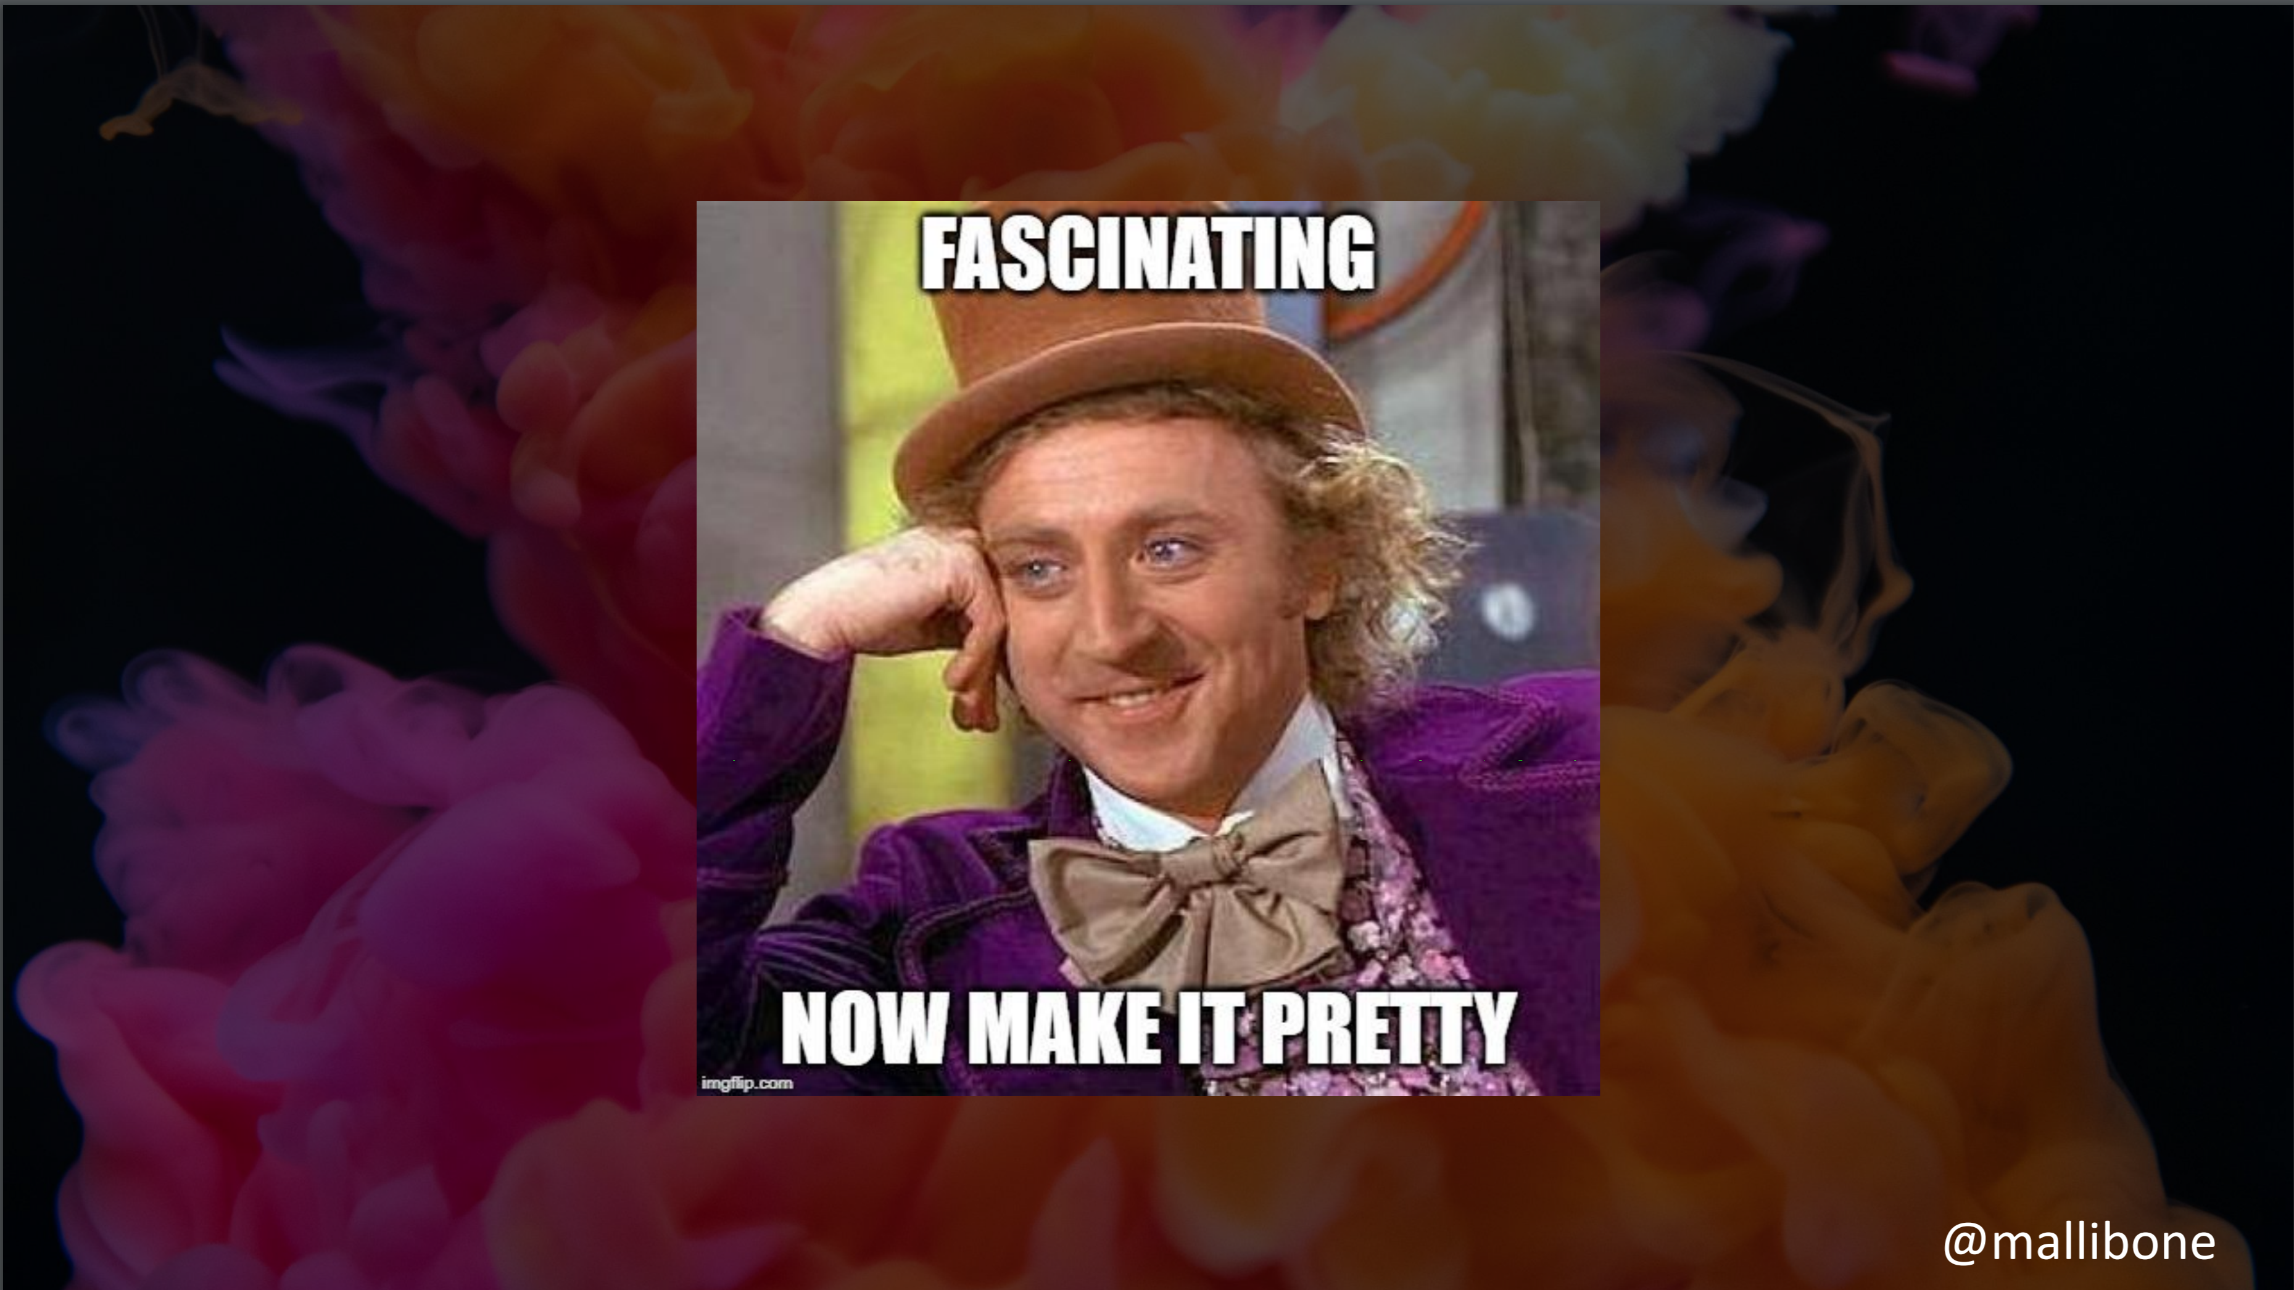

Slide 52
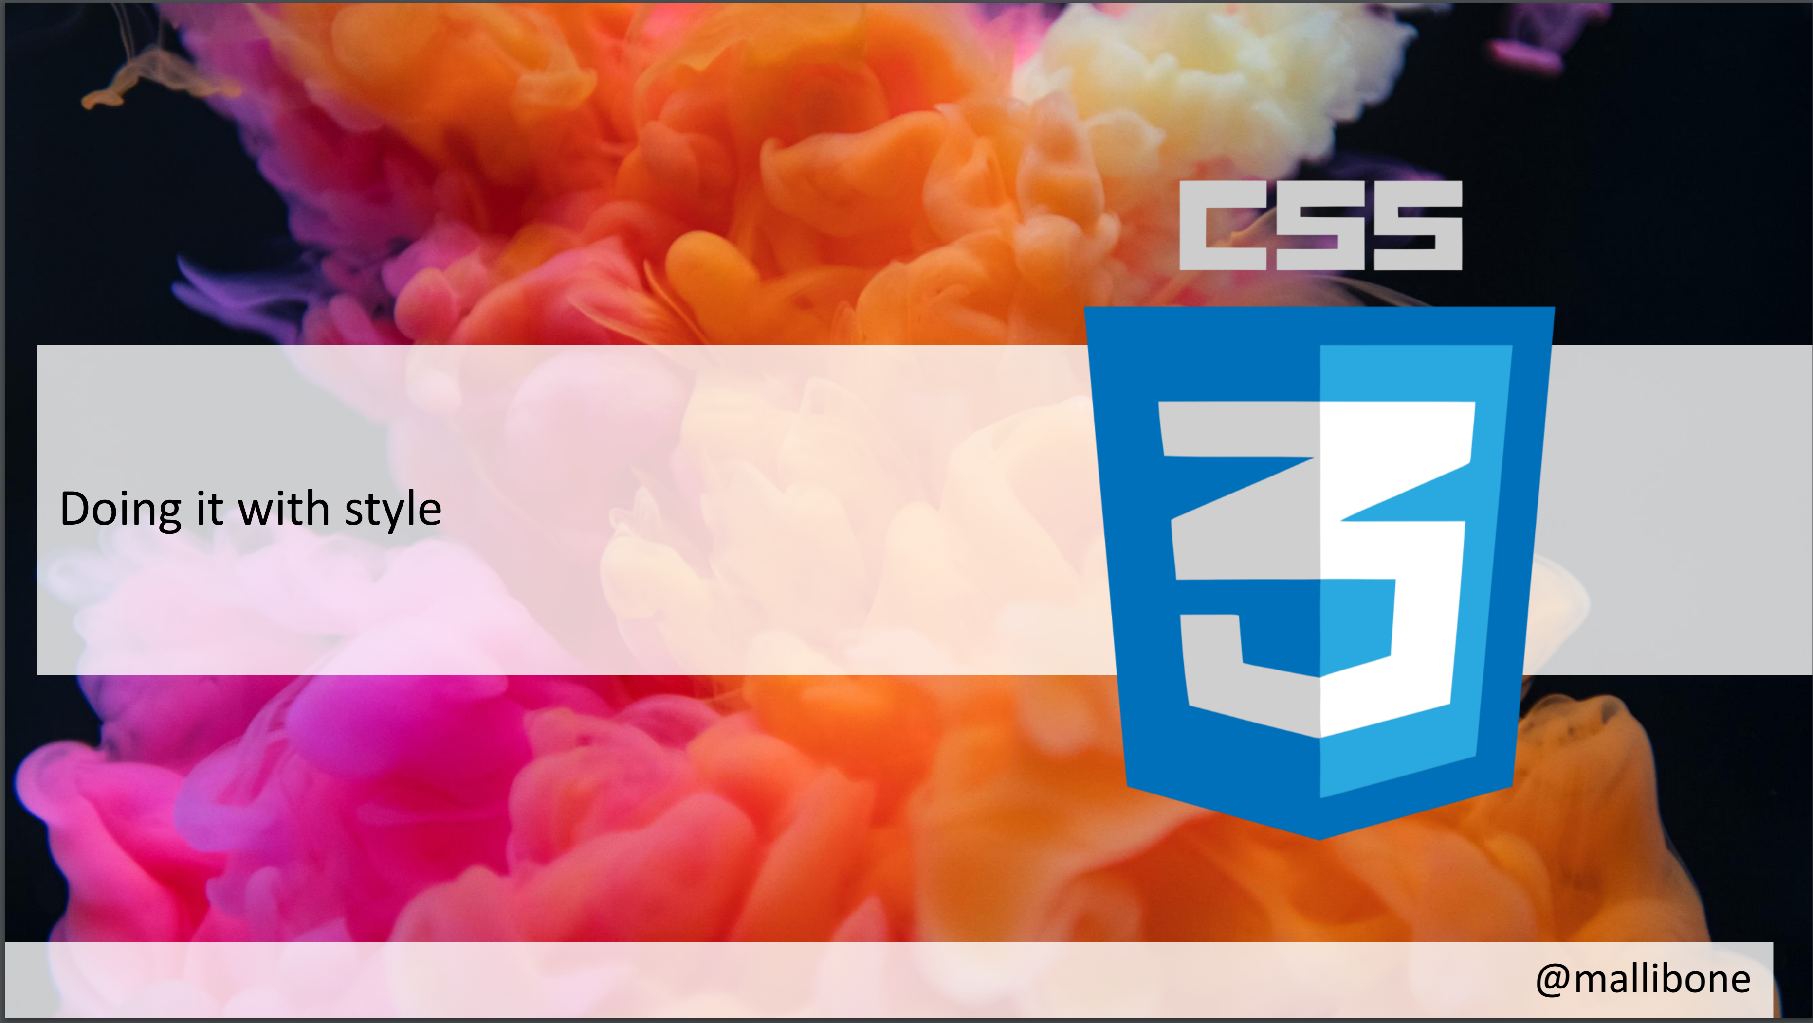

Slide 53
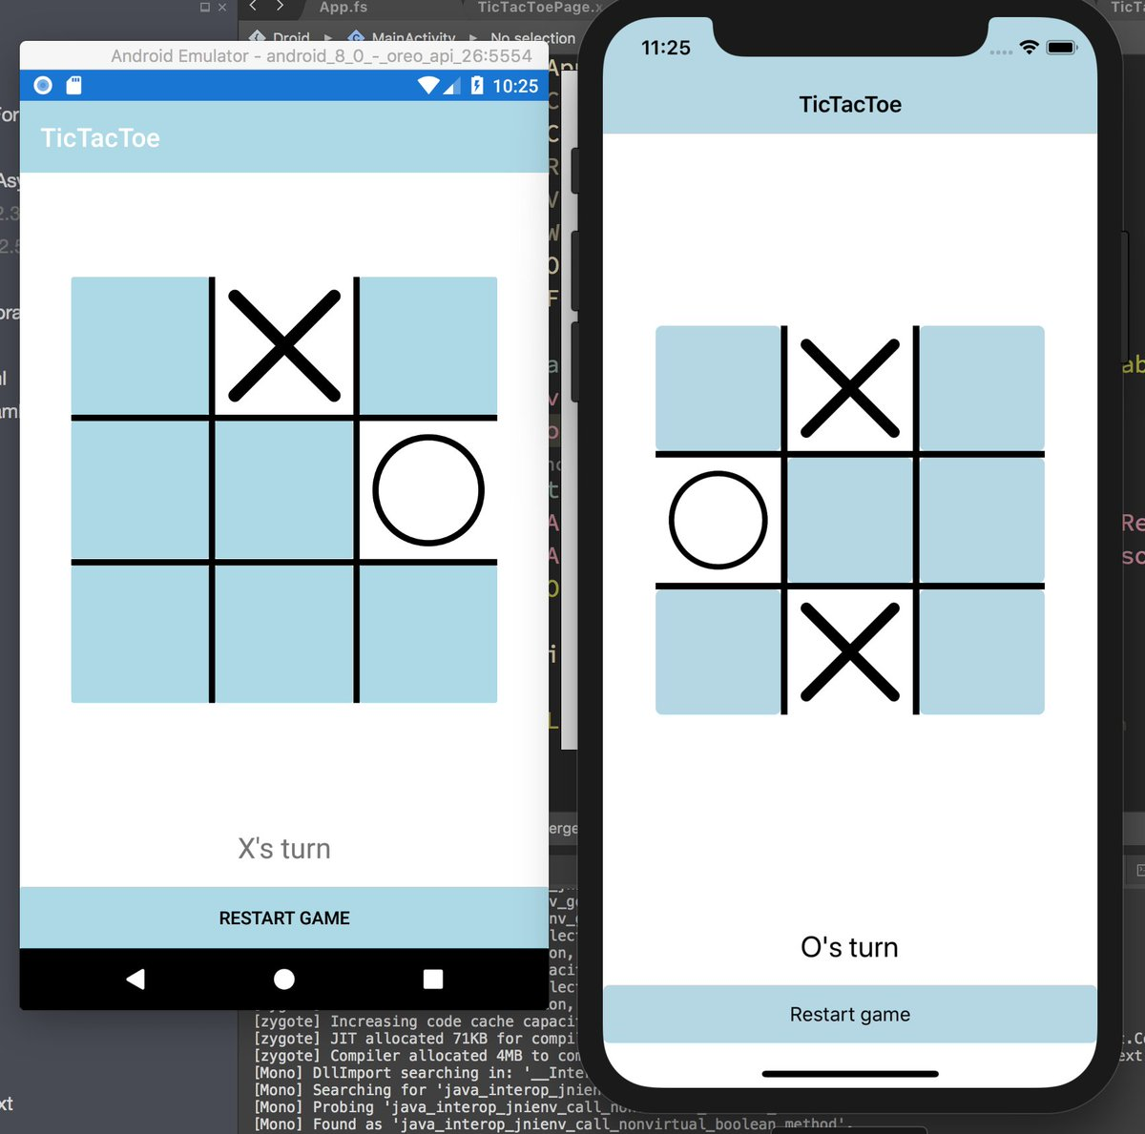
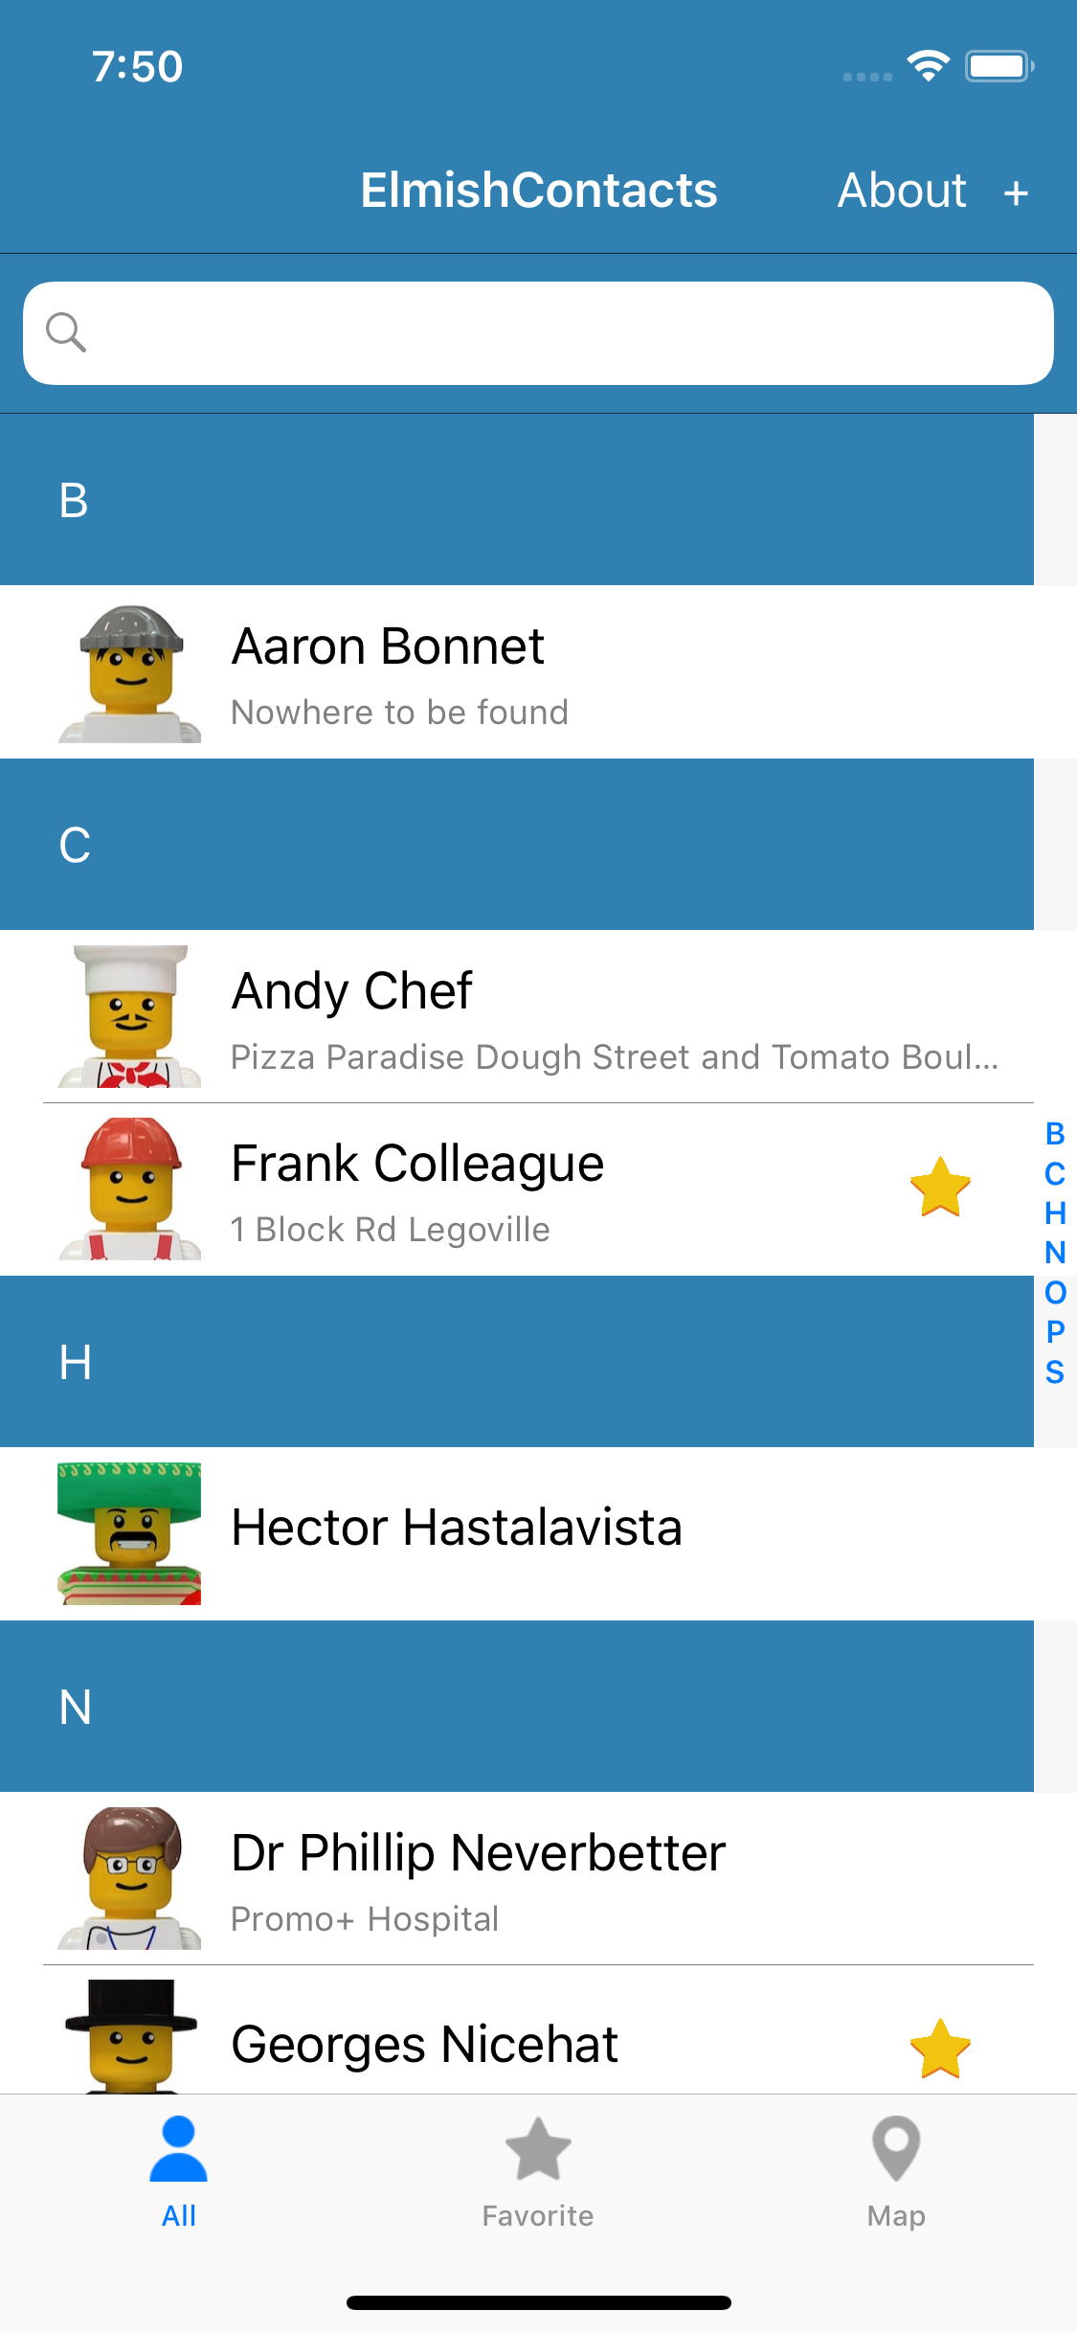
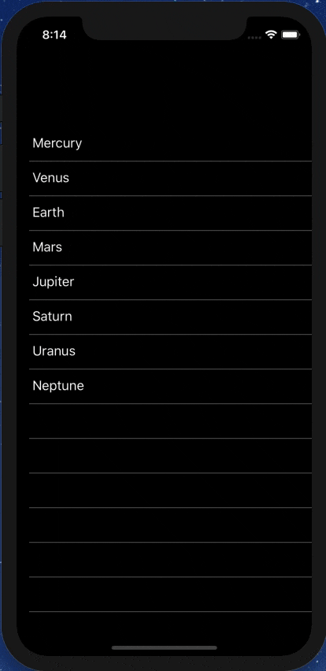
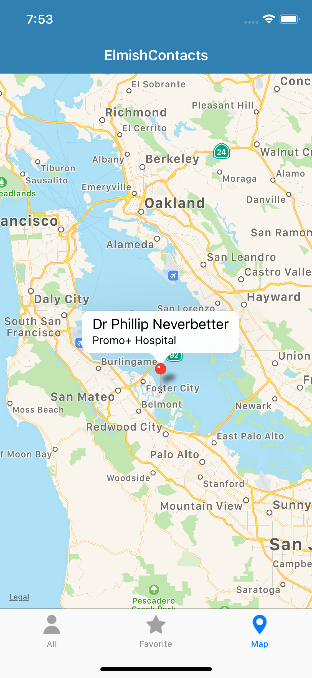
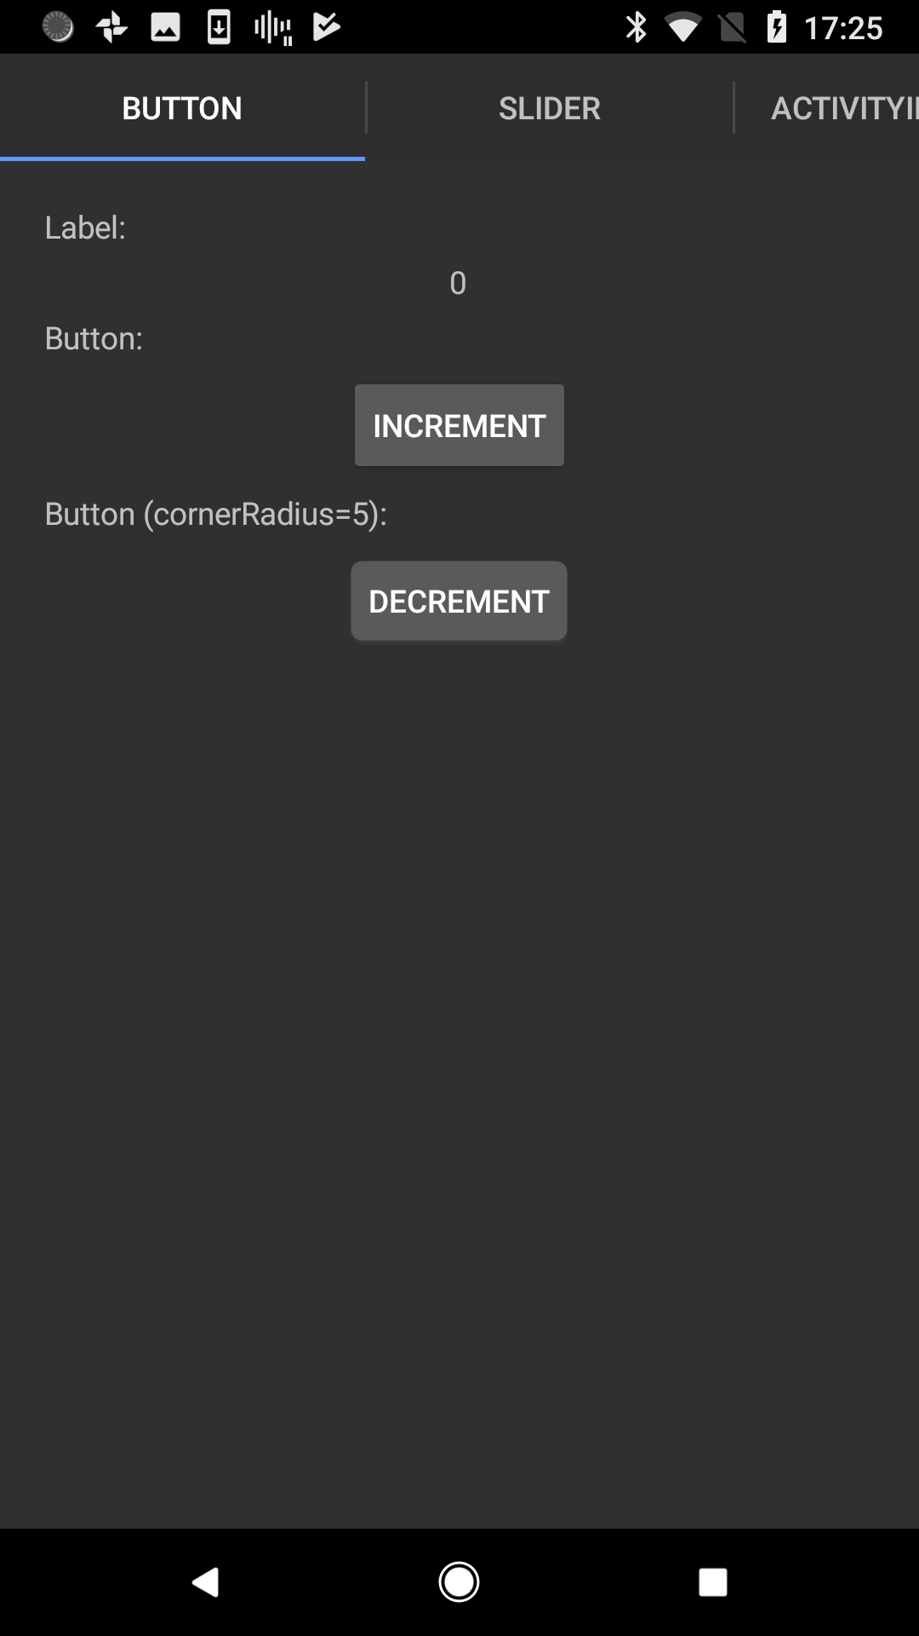

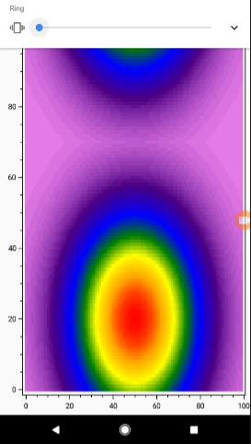


Slide 54
FABULOUS CONTACTS

Slide 55


Slide 56
FABULOUS - Making it FAST
let view model dispatch =
…
View.Slider(minimum=0.0, maximum=10.0,
value=double model.Count,
valueChanged=(fun args -> dispatch (SliderValueChanged args.NewValue)))
…
This is a tree of immutable data describing the view
We want to avoid reallocating this data and re-traversing on each model update

Slide 57
FABULOUS - Making it FAST
let view model dispatch =
…
dependsOn (…) (fun model (count, step) ->
…
)
…

Slide 58
FABULOUS - Making it FAST
let view model dispatch =
…
dependsOn (model.Count, model.Step) (fun model (count, step) ->
View.Slider(minimum=0.0, maximum=10.0,
value=double count,
valueChanged=(fun args -> dispatch (SliderValueChanged args.NewValue))))
…
This recycles subtrees that are unchanged. Unchanged subtrees are not diff’d

Slide 59
FABULOUS – MAKING IT FAST
‘dependsOn’ is good enough for many information apps
We can do better through treating views as adaptive data
Aim: Recover efficient incremental data binding within the MVU pattern
Work in Progress!

Slide 60
Δ

Slide 61
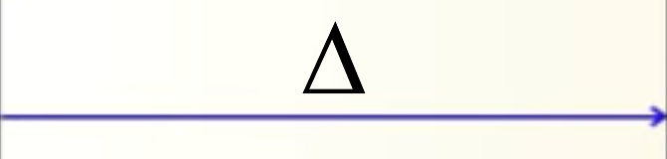
Δ
Δ

Slide 62
FSharp.Data.Adaptive
github.com/fsprojects/FSharp.Data.Adaptive/
F# immutable data as you know and like it, but event-sourced

Slide 63
FSharp.Data.Adaptive – Your Data as Incremental Computation
List.map
List. filter
List.sum
Δs
AList.map
Δs
AList.filter
Δs
AList.sum
Δ

Slide 64
FSharp.Data.Adaptive – Your Data as Incremental Computation
F# Immutable Data | F# Adaptive Data
int | aval<int>
list<int> | alist<int>
set<int> | aset<int>
map<int, int> | amap<int, int>
[ 1; 2; 3 ] | alist { 1; 2; 3}
1.0 + now.Seconds | aval { let! t = now return t.Seconds + 1.0 }
xs |> List.map (fun x -> x * x) |> List.filter (fun x -> x % 3 = 0) |> List.sum | xs |> AList.map (fun x -> x * x) |> AList.filter (fun x -> x % 3 = 0) |> AList.sum

Slide 65
FABULOUS – MAKING IT FAST (WIP)
open Fabulous
let view model dispatch =
View.ContentPage(
View.StackLayout(children = [
View.Image(source = "fabulous.png")
View.List(items = [
for item in model.Items ->
View.Label(sprintf "Item %s" item)
])
View.Button(text = "Add Item", command = (fun () -> dispatch AddItem))
]
)
1 million element list = 1 million items to diff on each update!!!

Slide 66
FABULOUS – MAKING IT FAST (WIP)
open FabulousAdaptive
let view model dispatch =
View.ContentPage(
View.StackLayout(children = cs [
View.Image(source = c "fabulous.png")
View.List(items = alist {
for item in model.Items ->
View.Label(c (sprintf "Item %s" item))
})
View.Button(text = c "Add Item", command = (fun () -> dispatch AddItem))
]
)
Now fully incremental through adaptive data
If an item is inserted, only one update is made
Invariant parts currently marked with ‘c’ or ‘cs’

Slide 67
FABULOUS - LEARN!
FabulousContacts for learning
On-device per-app SQL-Lite integration
Using maps
Asynchronous data loading onto maps
Catching exceptions and being robust
Sending SMS, making phone calls and Email using Xamarin.Essentials
Multi-page with external messages reconciled via the composed app
Editing and searching lists of things
Taking photos
Splash screens
Decent design

Slide 68
FABULOUS - Pragmatics
Animations
Multi-page apps
State persistence
Time-travel debugging
App size
Platform-specifics
Deploying
Extensibility

Slide 69
Summary

Slide 70
F# Emphasises Clear, Code to Solve Real-world Problems
MVU makes functional relevant to UI
Fabulously Adaptive makes it fully incremental
Fabulous brings MVU to cross-platform apps

Slide 71
Questions?

